Slide 1
35” CONDENSING GAS FURNACES
Vent and Combustion Air System
Design & Installation
Add Distributor Art and Text Here
Notes:
SCRIPT
Welcome to the training module for vent and combustion air system design and installation for the new 35 inch condensing furnace. This module will take about 20 minutes to complete.

Slide 2
Vent and Combustion Air Design and Installation
Contents
Section 1: New 35” Condensing Furnace Design
Section 2: National and International Codes
Section 3: Vent and Combustion Air System Design Rules
Section 4: Common Vent Installation Problems
Notes:
SCRIPT
This training module will review…
Key aspects of the new 35 inch condensing furnace design that affect the vent and combustion air system, the applicability of national and international plumbing and fuel gas codes, vent design considerations and requirements, and common vent installation problems.

Slide 3
Vent and Combustion Air Design and Installation
Section 1
35” Condensing Furnace Design
Notes:
SCRIPT
The new 35 inch condensing gas furnace is designed to achieve an ultra high AFUE. As a result, water from burning fuel gas condenses on more surfaces along the flue gas path than prior condensing furnace designs. The advancement in technology means vent and combustion air system design and installation is more important than ever. Let’s learn about the condensing furnace design differences and how they impact vent and combustion air system design.

Slide 4
Vent and Combustion Air Design and Installation
Flue Gas Water Vapor Comparison
Furnace Water Vapor
Vent
Legacy 92% New 92% New 98%
high
Flue Gas Temp
low
Vapor
Vapor
Total water vapor passed into vent
Vapor
Liquid
Liquid
Liquid
Liquid passed out furnace drain
Drain
Lower flue gas temps More liquid water in vent
Notes:
SCRIPT
Water vapor is formed when fuel gas (natural gas or propane) burns. The total amount of water vapor formed during combustion is nearly the same between the old and new condensing furnace designs. However, the new 35 inch furnace removes more heat from the flue gas than prior designs. So, the flue gas temperature passing into the vent from the new furnace is closer to the temperature at which water changes from vapor to liquid.
The old and new 92 percent AFUE furnaces form a similar amount of liquid water in the secondary heat exchanger. Liquid water is passed out of the furnace through the condensate drain. The temperature of the flue gas leaving the new 92 percent furnace is closer to the temperature at which water changes from vapor to liquid than the old 92 percent furnace.
The new modulating furnace has a higher AFUE, around 98 percent. To achieve 98 percent AFUE, more heat is removed from the flue gas in the secondary heat exchanger. Therefore, more water vapor changes to liquid in the secondary heat exchanger on a 98 percent AFUE furnace than a 92 percent AFUE furnace. Since more water is passed out through the condensate drain on a 98 percent AFUE furnace, less water vapor passes into the vent.
The temperature of the flue gas passing into the vent from the new furnace is closer to the temperature at which water changes from vapor to liquid than the old furnace. At lower AFUE ratings, this can result in more liquid water in the vent pipe. Let’s see how this impacts the vent system.

Slide 5
Vent and Combustion Air Design and Installation
Vent Liquid Water Load Comparison
Vent Liquid Water Load
Legacy 92% New 92% New 98%
Inducer
Airflow
Inducer
Airflow
Inducer
Airflow
Vapor
Vapor
Total water vapor passed into vent
Vapor
Liquid
Liquid
Liquid
Liquid passed out furnace drain
More liquid water in vent Vent slope is important
Notes:
SCRIPT
The flue gas temperature passing into the vent from the old condensing furnace was hot enough to keep most water in vapor form until after the vent outlet, only small amounts of liquid water collected in the vent pipe. In contrast, the flue gas temperature passing into the vent from the new furnace design is closer to the temperature at which water changes from vapor to liquid. Therefore, more water will change to liquid in the vent system with the new furnace design.
Generally, the same amount of water vapor enters the vent between the new and old 92 percent AFUE condensing furnaces. However, more water vapor will change to liquid in the vent with the new furnace design.
The general fuel gas code and our vent and combustion air system requirements have not changed in two decades. The new furnace was designed to function with a vent system that meets existing vent requirements. Because more water transitions from vapor to liquid in the vent, proper vent design and installation is more important now than prior condensing furnace designs.
Vent slope is more important. If a vent system has less than ¼ inch per foot slope toward the furnace and cannot be fixed, a modulating furnace is the best choice because most of the water turns to liquid in the secondary heat exchanger and not the vent.

Slide 6
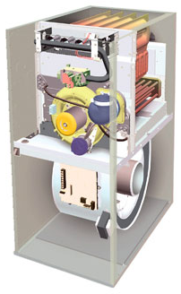
Vent and Combustion Air Design and Installation
Pressure Switch Operation: Single and 2-Stage
LPS (Low Pressure Switch)
Measures: collector box pressure
Purpose: Prevent furnace from running with a partially or fully blocked heat exchanger, trap or condensate drain
Heat Exchanger
Collector Box
Trap
Pressure Switch
Low Pressure Switch is used to prevent carbon monoxide from entering a living space.
Notes:
SCRIPT
The low stage pressure switch, called LPS on the wiring diagram, measures the collector box pressure and is a safety switch to stop the furnace from running when the heat exchanger, trap or condensate drain is partially to fully blocked. When a flue gas passage becomes partially to fully blocked the burners starve for combustion air. Without the low pressure switch, the burner would make carbon monoxide (also known as CO) that could enter a living space.

Slide 7
Vent and Combustion Air Design and Installation
Pressure Switch Operation: Single and 2-Stage
HPS (High Pressure Switch)
Measures: inducer housing pressure
Purpose: Prevent furnace from running with a partially or fully blocked vent
Inducer Housing
Pressure Switch
High Pressure Switches is used to prevent carbon monoxide from entering a living space.
Notes:
SCRIPT
The high stage pressure switch, called the HPS on the wiring diagram, measures the inducer housing pressure and is a safety switch to stop the furnace from running when the vent is partially to fully blocked. Modulating furnaces use collector box pressure to check vent pressure. When the vent becomes partially to fully blocked the burners starve for combustion air. Without the high pressure switch, the burner would make carbon monoxide that could enter a living space.

Slide 8
Vent and Combustion Air Design and Installation
Pressure Switch Operation: Single and 2-Stage
LPS (Low Pressure Switch)
Measures: collector box pressure
Purpose: Prevent furnace from running with a partially or fully blocked heat exchanger, trap or condensate drain
Status Code 3 (Single & 2-stage models)
HPS (High Pressure Switch)
Measures: inducer housing pressure
Purpose: Prevent furnace from running with a partially or fully blocked vent
Pressure switches are used to prevent carbon monoxide from entering a living space.
Pressure switches are not for “furnace proving”.
Notes:
SCRIPT
Both pressure switches are used to shut down the furnace before carbon monoxide enters the living space. These pressure switches should not be thought of as “furnace proving” switches since they check for flue gas and condensate drain passage blockage during all stages of heating operation.
Status code 3 on single and two-stage condensing furnaces will flash when a flue gas or condensate drain passage in the furnace; vent, combustion air and/or condensate drain pipes become partially to fully blocked . The high or low pressure switch can trigger a status code 3. Two-stage furnaces will continue to operate in low stage if the high stage pressure switch does not close.

Slide 9
Vent and Combustion Air Design and Installation
Section 2
National and International Codes
Notes:
SCRIPT
Now we would like to review national and international codes that guide vent and combustion air system design and installation.

Slide 10
Vent and Combustion Air Design and Installation
Plumbing Codes and Furnace Vent Systems
National Standard Plumbing Code 2009
International Plumbing Code 2012
  NSPC plumbing definition excludes piping for ‘environmental control’.
  IPC plumbing definition excludes fuel gas appliance exhaust or combustion air.
  NSPC vent definitions do not refer to fuel gas appliance exhaust.
  IPC vent definitions do not include fuel gas appliance exhaust or combustion air.
The National and International Plumbing Codes do not apply to gas furnace vent systems.
Notes:
SCRIPT
The 2009 National Standard Plumbing Code does not apply to piping for ‘environmental control’ and the 2012 International Plumbing Code does not apply to gas furnace vent and combustion air piping. Therefore, the national and international plumbing codes do not apply to gas furnace vent and combustion air piping.

Slide 11
Vent and Combustion Air Design and Installation
Fuel Gas Codes and Furnace Vent Systems
NATIONAL FUEL GAS CODE 2012 ANSI Z223.1, NFPA 54
INTERNATIONAL FUEL GAS CODE 2012*
*IFGC applies to residential gas furnaces in 1 or 2 family dwellings and townhouses.
  NFGC and IGFC refer to manufacturer’s Installation Instructions for vent design, sizing and installation.
  IFGC refers to manufacturer’s Installation Instructions for vent support, combustion and ventilation air requirements
  Vent and combustion air termination location is specified in NFGC.
  Make-up and combustion air is specified in IFGC.
Refer to National and International Fuel Gas Codes and manufacturer’s Installation Instructions for vent, combustion air, ventilation and make-up air design and installation.
11
Notes:
SCRIPT
The 2012 National Fuel Gas Code, also known as ANSI Z223.1 and NFPA 54, refers to the manufacturer’s installation instructions for vent design, sizing and installation. The National Fuel Gas Code also limits vent and combustion air termination locations.
The 2012 International Fuel Gas Code refers to the manufacturer’s installation instructions for vent support, combustion and ventilation air requirements; but sets make-up and combustion air requirements.
It is important to understand the vent and combustion air requirements in the National and International Fuel Gas Codes and the manufacturer’s installation instructions. These are the main sources of information for vent design and installation requirements, so regular review is recommended.

Slide 12
Vent and Combustion Air Design and Installation
Section 3
Vent and Combustion Air System Design Rules
Notes:
SCRIPT
The following section will explain venting and combustion air system design requirements and considerations when designing a vent and combustion air system.

Slide 13
Vent and Combustion Air Design and Installation
Vent Design Rules
Do not exceed the maximum equivalent vent length in the Installation Instructions.
Affect on Operation: Vent system pressure drop is too high. Burners starved of combustion air resulting in incomplete combustion.
Maximum Equivalent Vent Length (Example)
Notes:
SCRIPT
Do not go over the maximum vent length stated in the installation instructions. When the total equivalent vent length is longer than the maximum vent length, the pressure drop is too high for the inducer to overcome. To prevent carbon monoxide from entering the living space, the pressure switch will open and shut down the furnace.
For example, a total equivalent vent length of 30 feet is needed for an 80,000 BTU condensing furnace. The installer chooses to use 1½ inch diameter pipe, which has a maximum equivalent vent length of 15 feet. A 30 foot equivalent vent is longer than the 15 feet maximum equivalent vent length allowed and will cause too much pressure drop, open the pressure switch and shut down the furnace. Two inch pipe is a better choice because the maximum equivalent vent length, 50 feet, is more than the total equivalent length, 30 feet.

Slide 14
Vent and Combustion Air Design and Installation
Vent Design Rules
Use the smallest practical vent diameter listed in the Installation Instructions.
Affect on Operation: Vent system pressure drop is too low. Too much combustion air causes an unstable flame.
Maximum Equivalent Vent Length (Example)
Notes:
SCRIPT
The smallest practical vent diameter should be used for vent and combustion air pipes. If the vent system pressure drop is too low, too much combustion air will enter the burners resulting in unstable flame which can also cause carbon monoxide. If the flame is unable to maintain current at the flame sensor, the furnace will shut down.
For example, the installer chooses to use 3 inch diameter pipe and needs a total equivalent vent length of 45 feet for an 80,000 BTU condensing furnace. The maximum equivalent vent length for 3 inch diameter pipe is 175 feet. The installer finds the flames are unable to maintain current at the flame sensor and the furnace shuts down. A better choice of pipe diameter is 2 inch because the maximum equivalent vent length, 50 feet, is just over the total equivalent vent length, 45 feet.

Slide 15
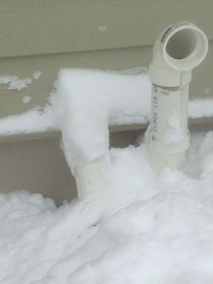
Vent and Combustion Air Design and Installation
Vent Design Rules
Locate vent and combustion air terminations above the anticipated snow line.
Affect on Operation: Vent or combustion air termination becomes partially or fully blocked by snow or ice. Burners starved of combustion air resulting in incomplete combustion.
Notes:
SCRIPT
All vent and combustion air terminations must be located a minimum one (1) foot above the anticipated snow line for your area. Local codes may require more clearance. This minimizes the possibility of the vent or combustion air pipes becoming blocked by snow or ice. Flue gas from a condensing furnace is not hot enough to melt through layers of snow or ice.
When the vent becomes partially to fully blocked by snow or ice, a pressure switch will open and shut down the furnace before carbon monoxide can enter the living space. When the combustion air termination becomes partially to fully blocked with snow or ice the flame sensor or pressure switch will shut down the furnace.

Slide 16
Vent and Combustion Air Design and Installation
Vent Design Rules
Space combustion air and vent terminations away from another fuel gas appliance vent termination, dryer vent and plumbing stack by the distance stated in the National or International Fuel Gas Code
Affect on Operation: Vent or combustion air termination becomes partially or fully blocked by ice. Burners starved of combustion air resulting in incomplete combustion.
Affect on Operation: Flue gas is pulled into combustion air termination. Burners starved of oxygen resulting in incomplete combustion.
Notes:
SCRIPT
Place combustion air terminations away from other fuel gas appliance vents, dryer vents and plumbing stacks. Refer to the latest version of the National Fuel Gas Code for spacing requirements. When the combustion air termination is located too close to a moist exhaust, the furnace may create carbon monoxide.
When the vent becomes partially to fully blocked by snow or ice, a pressure switch will open and shut down the furnace before carbon monoxide can enter the living space. When the combustion air termination becomes partially to fully blocked with snow or ice the flame sensor or pressure switch will shut down the furnace.

Slide 17
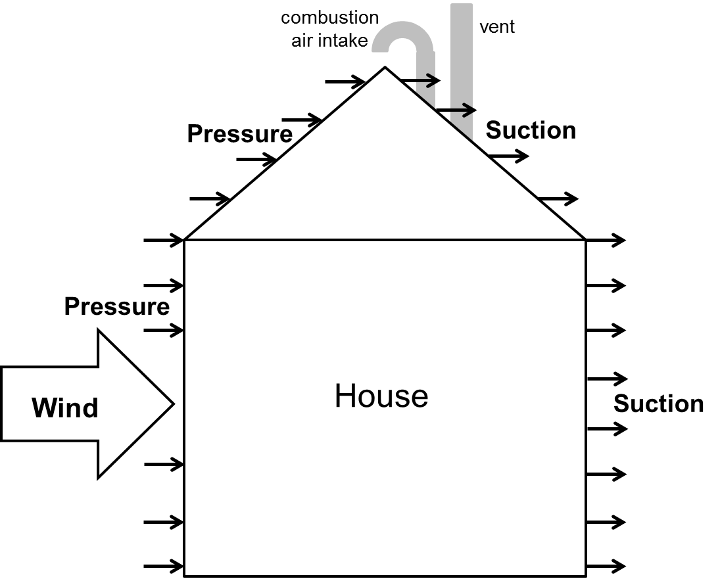
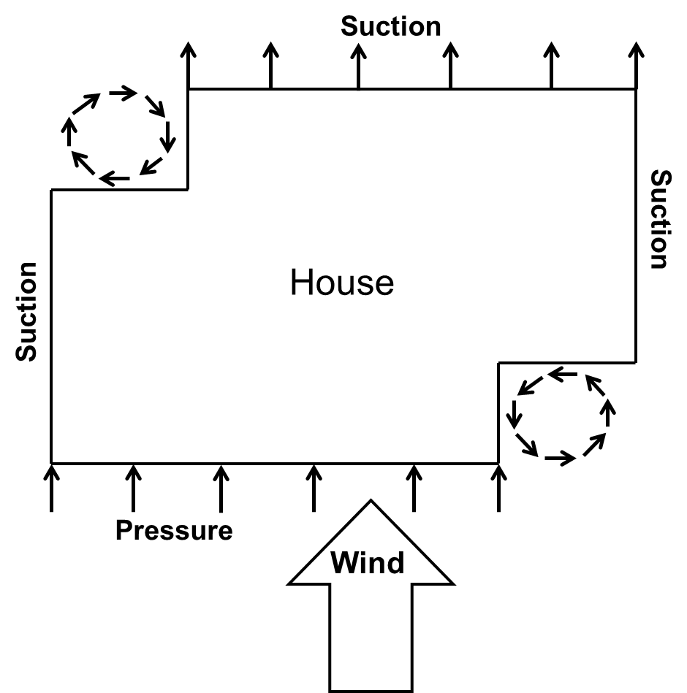
Vent and Combustion Air Design and Installation
Vent Design Rules
Locate vent and combustion air termination is in a space that is protected from prevailing winds.
Affect on Operation: Inducer is unable to overcome wind pressure.
Notes:
SCRIPT
Condensing furnace inducers are designed to deliver combustion air to the burners. The inducer is not designed to push out flue gas against high winds or high pressure; therefore, it is important to locate the vent and combustion air terminations where strong wind does not push against flue gas flow.
Locate the vent termination in a space that is protected from prevailing winds that occur during the heating season. Prevailing wind direction and speed is different from region to region.
Locating condensing furnace vent and combustion air terminations in against high prevailing winds may cause a pressure switch or flame sensor to shut down the furnace.

Slide 18
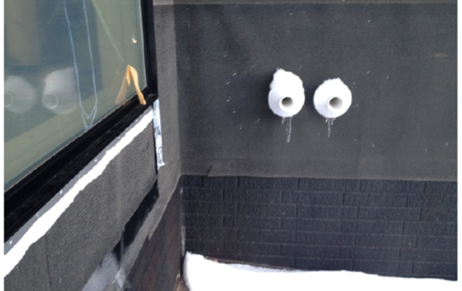
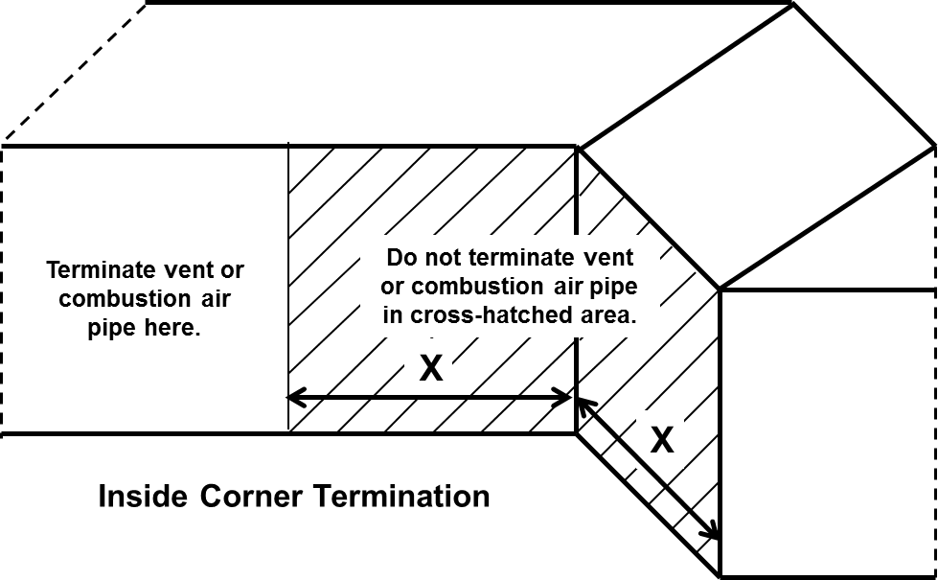
Vent and Combustion Air Design and Installation
Vent Design Rules
Do not locate vent and combustion air terminations on an inside corner as described in the Installation Instructions.
Affect on Operation: Combustion products are pulled into combustion air termination. Burners are starved of oxygen resulting in incomplete combustion.
Notes:
SCRIPT
Pressure at an inside corner can be 4 to 5 times the pressure due to wind vortices than that of the pressure on a straight wall. Therefore, do not terminate a vent on an inside corner which is the cross-hatched area on the diagram. Terminations can be located outside the cross-hatched area.
Locating condensing furnace vent and combustion air terminations on an inside corner may cause a pressure switch or flame sensor to shut down the furnace.

Slide 19
Vent and Combustion Air Design and Installation
Section 4
Vent Installation Problems
Notes:
SCRIPT
Now let’s discuss common vent installation problems.

Slide 20
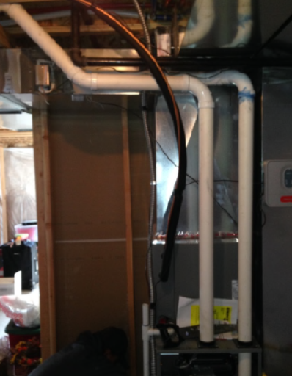
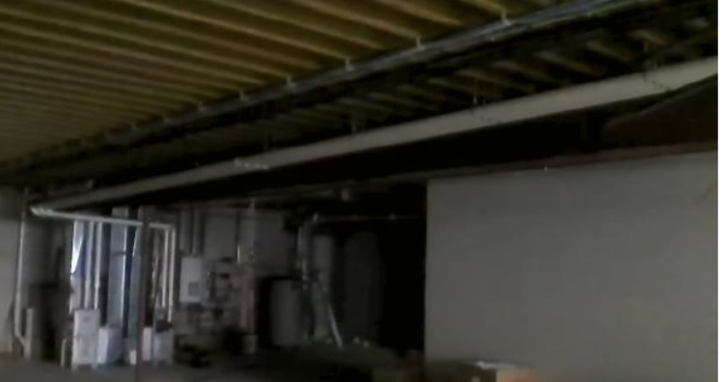
Vent and Combustion Air Design and Installation
Common Vent System Installation Problems
Pipe slope is less than ¼” per foot toward furnace.
Affect on Operation: Liquid water collects at elbows or horizontal sections causing partial blockage and water slugs create pressure waves.
Notes:
SCRIPT
There are three common vent system installation problems that will result in the pressure switch opening.
The first installation problem is installing vent pipe with less than ¼ inch per foot slope towards the furnace. The vent must be sloped a minimum of ¼ inch per foot to assist flow of water from the vent to the furnace condensate drain.
Water will collect at the low points in the vent system. When the mass of water become large enough, a slug can rush back to the furnace creating a pressure wave that will open the pressure switch.

Slide 21
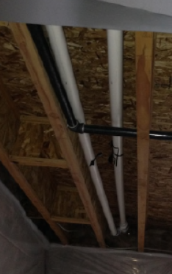
Vent and Combustion Air Design and Installation
Common Vent System Installation Problems
Too much space between pipe support resulting in sags.
Affect on Operation: Liquid water collects in the low section of vent pipe, which causes partial blockage and pressure changes.
Notes:
SCRIPT
The second installation problem is too much space between pipe supports. As water vapor changes to liquid in the vent pipe, it collects at low points. The pipe will begin to sag between supports under the weight of the water.
Water will collect at the low points in the vent pipe. The mass of water can slosh back and forth in the pipe creating a pressure wave that is picked up by the pressure switch. The pressure switch can open shut down the furnace.

Slide 22
Vent and Combustion Air Design and Installation
Common Vent System Installation Problems
Horizontal sections less than 4 feet must have a minimum ¼” per foot slope to the furnace.
Affect on Operation: Liquid water collects in horizontal section causing partial blockage and water slugs create pressure waves.
Notes:
SCRIPT
The third installation problem is a special case of too little slope. Ninety (90) degree elbows tend to be stiff and not allow short sections of horizontal pipe to meet the ¼ inch per foot slope minimum. It is recommended 45 degree elbows are used where short horizontal offsets are needed near the furnace.

Slide 23
Vent and Combustion Air Design and Installation
Results of Poor Vent System Design and Installation
Pressure Switch Opens
Loss of Flame Sense
No Heat
Customer Dissatisfaction
Notes:
SCRIPT
Good vent and combustion air system design will minimize pressure switch tripping, loss of flame sense, no heat calls and customer dissatisfaction.
For further information, please refer to the furnace installation instructions and the latest release of the National or International Fuel Gas Codes.
This completes the training on the new 35 inch condensing furnace vent and combustion air system design and installation rules.

